Slide 1


What we can do in the future?
By Richard Jiang
The future is present -----Mobile Team

Slide 2
Changes From System IOS Upgrade
To add description for camera, location…
<allow-intent href="tel:*" />.
Better to use HTTPS for our application.
To configure the whitelist on ios 9.0+

Slide 3
Changes From System Android Upgrade
Permissions your way.
Performance Monitor.
Upgrade Platforms.
To access Internet.

Slide 4
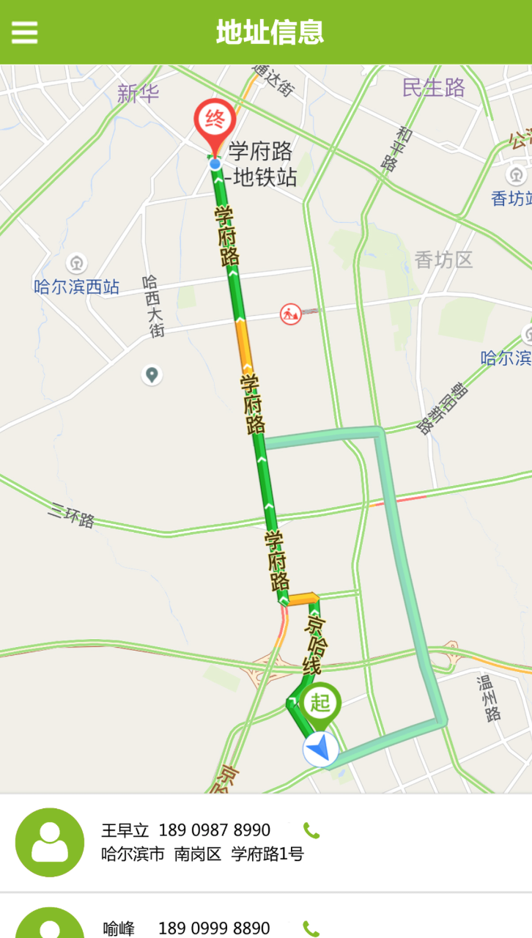
Map Function in Hybird Application.
How to make the route and marker?
How to implement the navigation function?
How to open external baidu map?
How to configure on different platforms?

Slide 5

Why is CodePush?
Open source from Microsoft.
Have a good performance.
Release any files(eg. Image, js, css)
Support rollback last version.

Slide 6

Record Audio and breakpoint upload
Record Audio By MPEG4(.m4a)
Upload big file by Socket Service.
Can support pause and restart.
Simple Demo case for this function.

Slide 7
React-Native For Mobile App
Made by Facebook, it is open source.
Based on Components.
Native Driver Application.
It is very popular and widely used for now.

Slide 8


